Slide 1
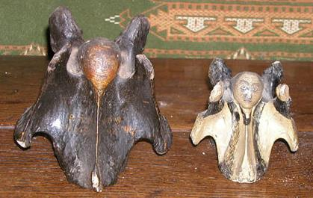
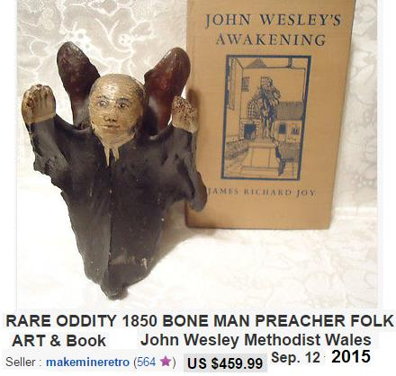
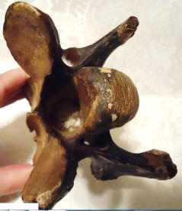
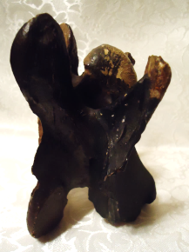
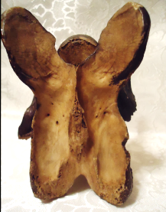
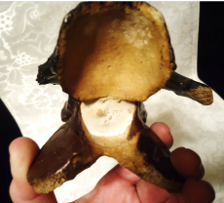
http://the-philosophers-stone.com/articles/bones/bones2.htm
http://www.ebay.com/itm/RARE-ODDITY-1850-BONE-MAN-PREACHER-FOLK-ART-Book-John-Wesley-Methodist-Wales-/311422736497

